Slide 1

IST 402 Network Security Behind the Scenes LM4
Joe Oakes
Penn State Abington

Slide 2

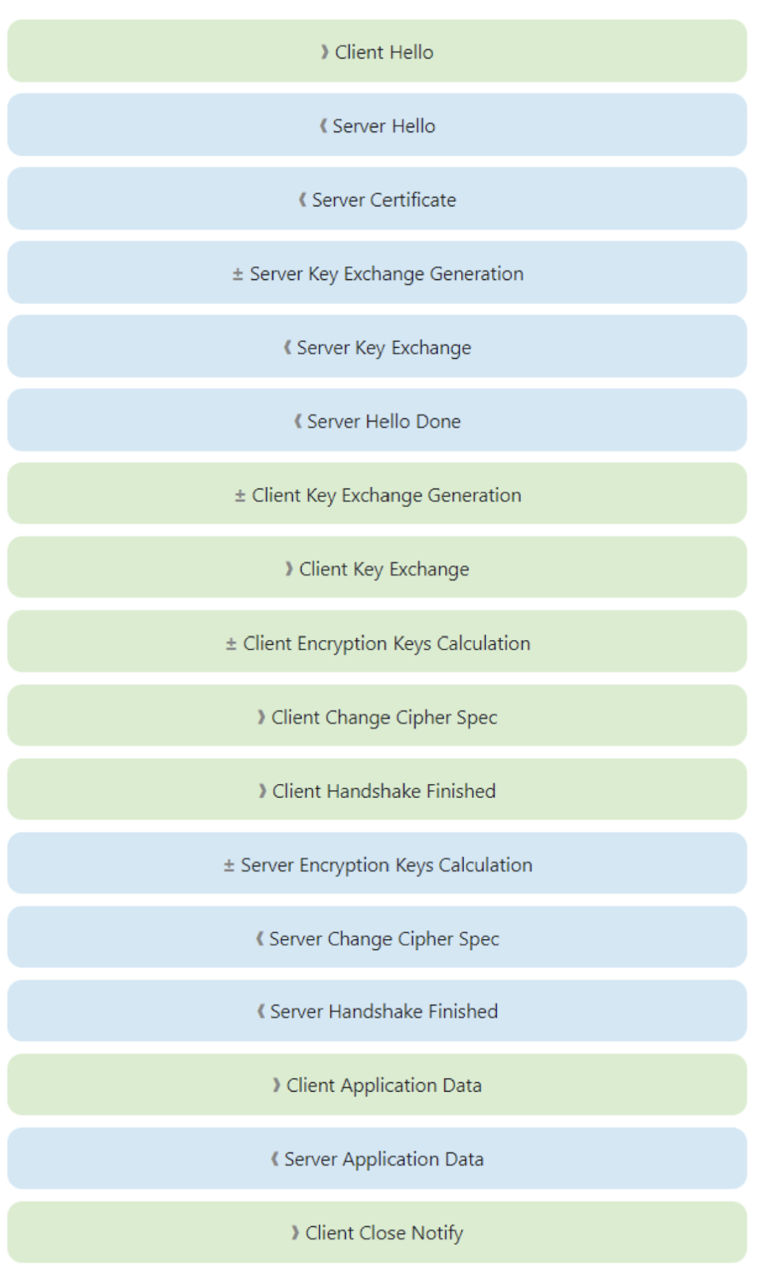
TLS: Handshaking: Client and Server
Client
Message using TLS 1.2
Server

Slide 3
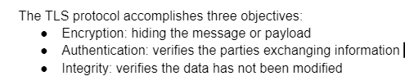
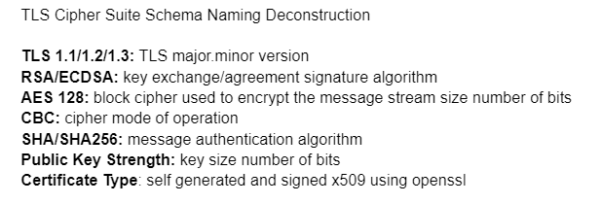
TLS Transport Layer Security
Transport Layer Security methods needed to perform
Key Exchange share a password
Encryption Ciphers
Block Chaining
Hashing check Integrity
Random number generation
Encoding
Certificates
Work with protocols
Work with handshaking

Slide 4
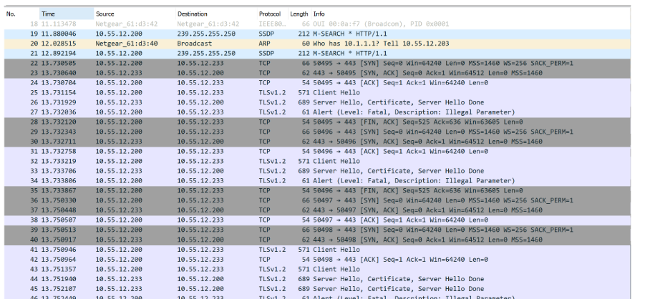
TLS: Why use it: Asymmetric Encryption
Encryption: the process of hiding the messages sent from one computer to another by changing the content to be unreadable
The public key is public to everyone. The private key is uniquely associated with the owner and is not made public.
Notice the wireshark capture
Client
Message using TLS 1.2
Server
Hacker using a Packet Sniffer
Cannot decipher the payload

Slide 5
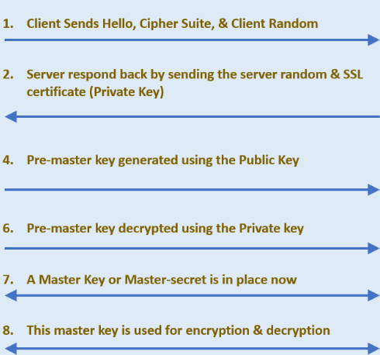

TLS: Client -Server Handshaking
Notice there is handshaking that takes place between the client and the server with TLS

Slide 6
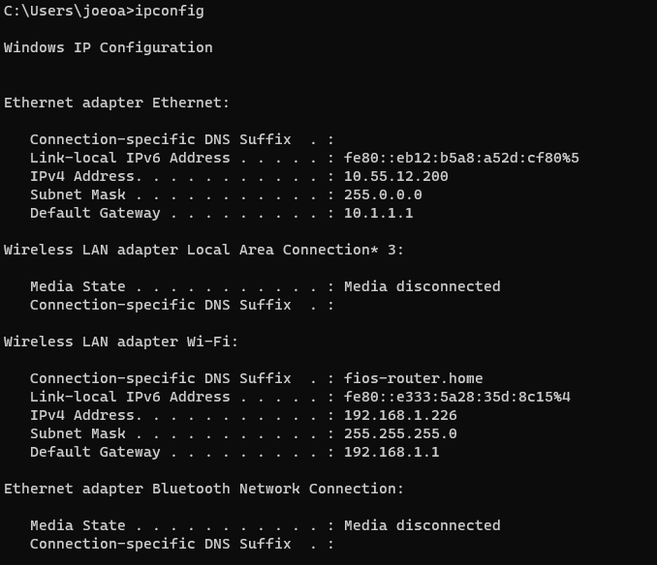
TLS: Determine the IP Address
Determine the IP address of the localhost computer
Use the command ipconfig
Notice this computer has two connections: wired Ethernet connection and a Wi-Fi connection
The gateway IP is how you get off your LAN to the Internet

Slide 7
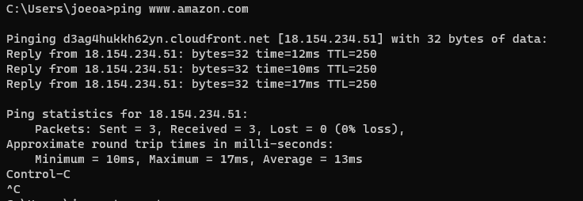
TLS: Determine the IP Address
Notice there is handshaking that takes place between the client and the server with TLS

Slide 8
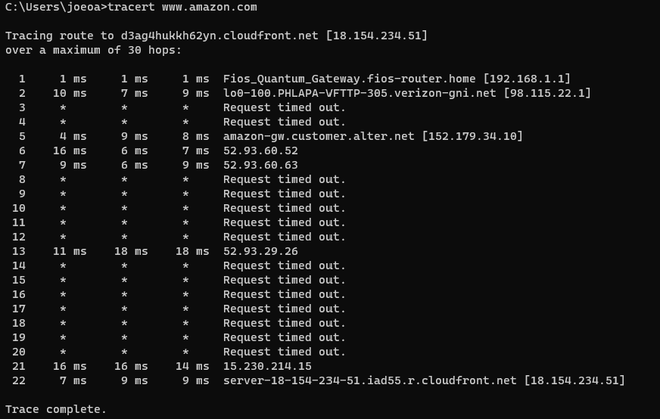
TLS: Tracerroute
Traces through the WAN routers showing the hops to get to the destination

Slide 9
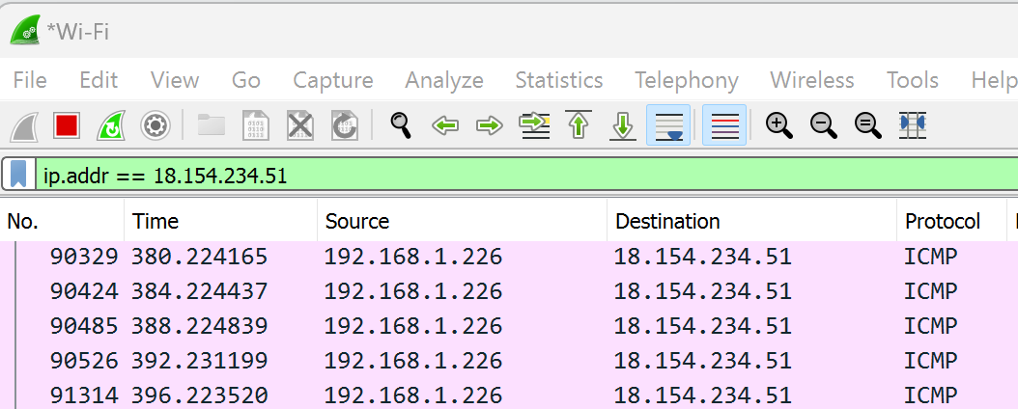
TLS: Wireshark: Packet Tracing
Notice there is handshaking that takes place between the client and the server with TLS
Notice I am filtering by IP address
Client
192.168.1.226
Message using TLS 1.2
Server
18.154.234.51

Slide 10
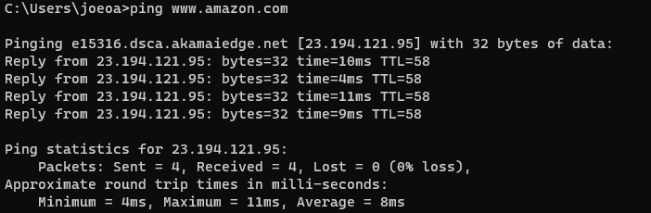
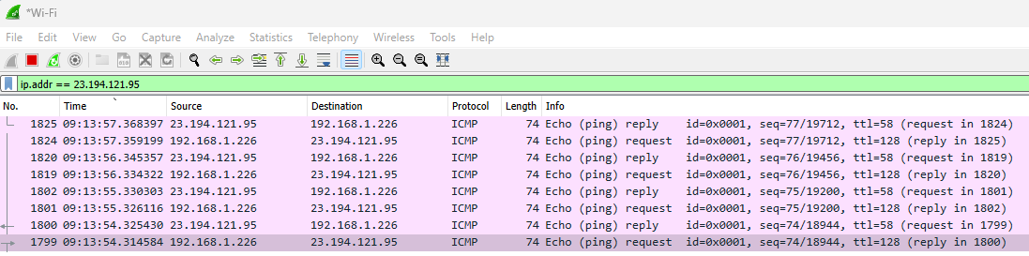
TLS: Wireshark: Packet Tracing
Notice Amazon IP address changed
Could be load balancing
Multiple web servers
Notice the request and the reply

Slide 11
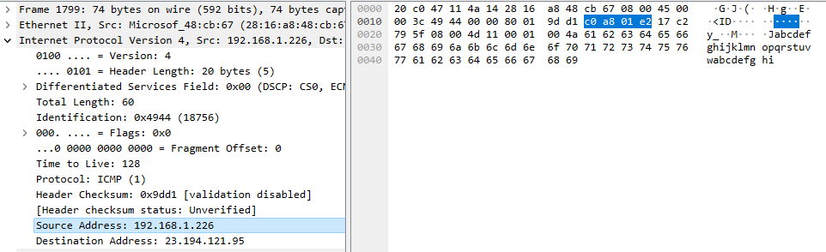
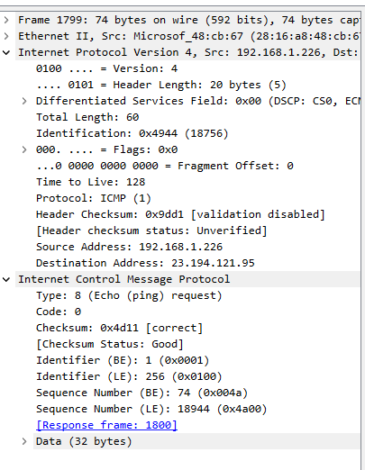
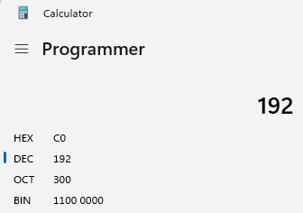
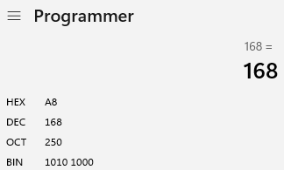
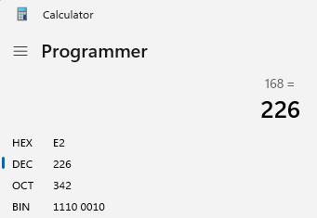
TLS: Wireshark: Packet Tracing: ICMP
Internet Control Message Protocol ICMP

Slide 12
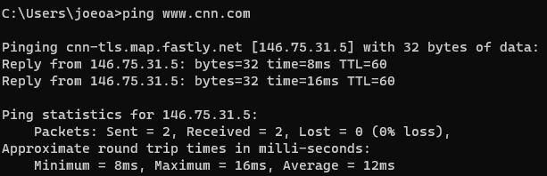
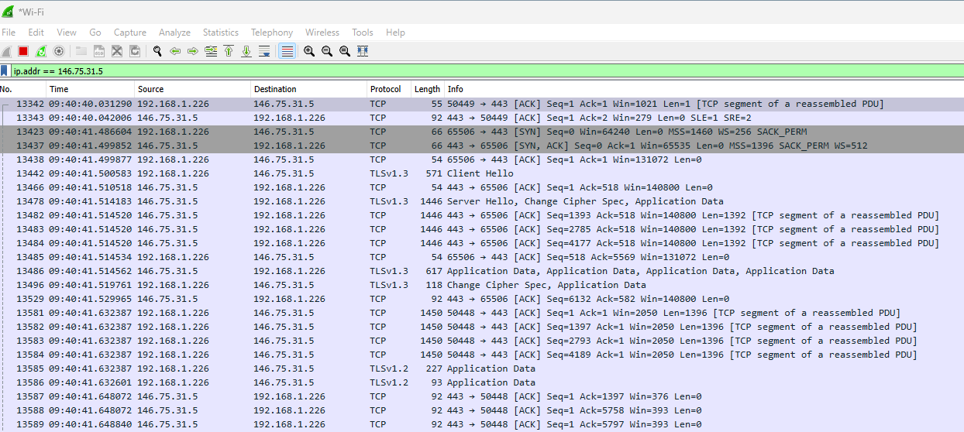
TLS: Wireshark: Packet Tracing: ICMP
Internet Control Message Protocol ICMP

Slide 13
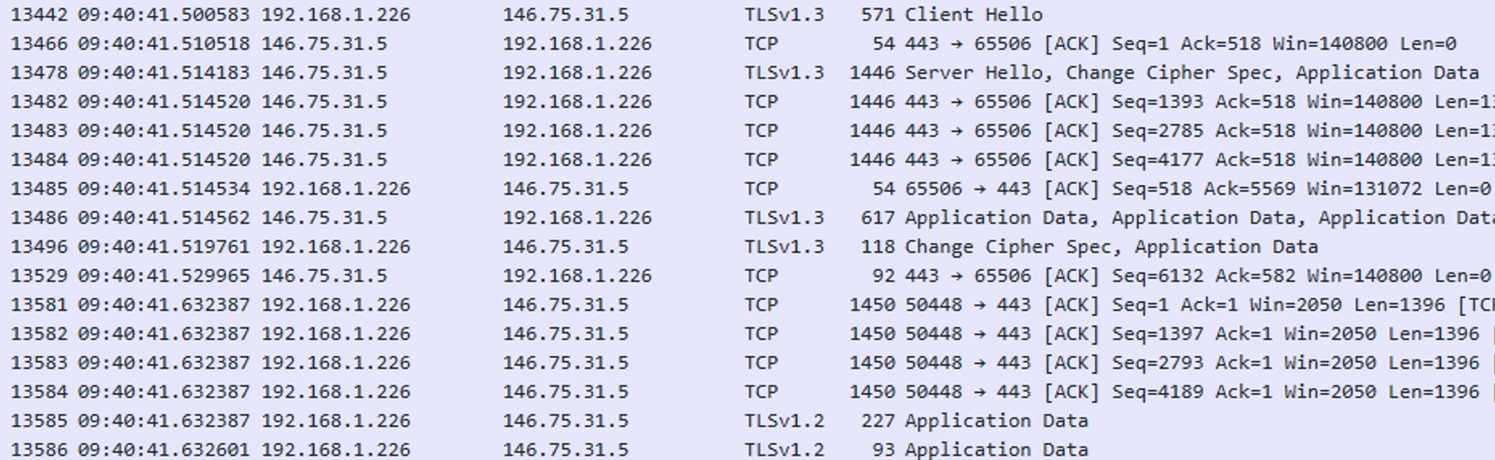
TLS: Wireshark: Handshaking Client -> Server
Client
192.168.1.226
Message using TLS 1.2
Server
146.75.31.5

Slide 14
TLS: Wireshark: Handshaking
Client
192.168.1.226
Message using TLS 1.2
Server
146.75.31.5

Slide 15
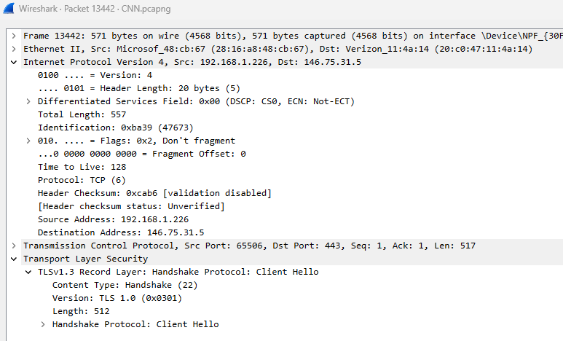
TLS: Wireshark: IP Internet Protocol
IP
TCP
TLS

Slide 16
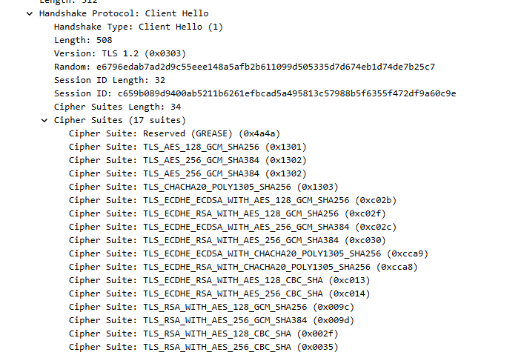
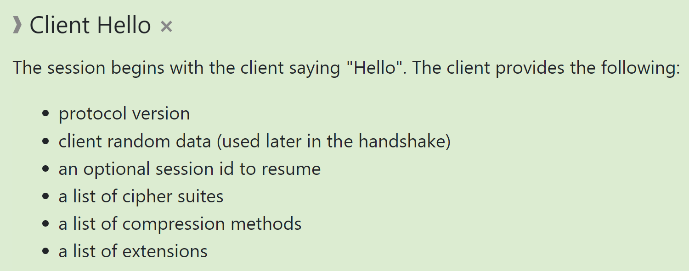
TLS: Wireshark: Client Hello
Client
192.168.1.226
Message using TLS 1.2
Server
146.75.31.5

Slide 17
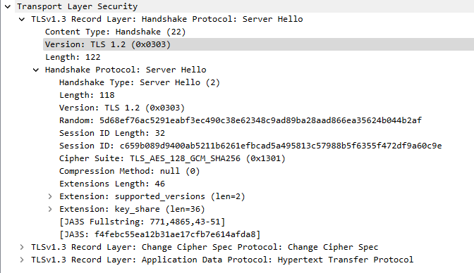
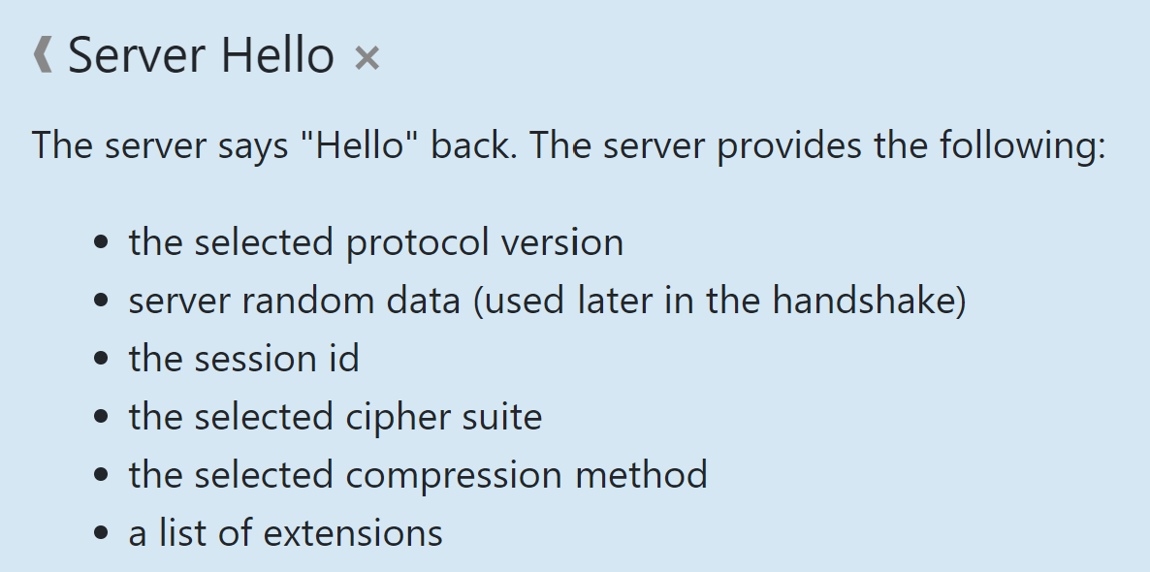
TLS: Wireshark: Server Hello
The TLS server responds with a “server hello” message that contains the CipherSuite chosen by the server from the list provided by the client, the session ID, and another random byte string. The server also sends its digital certificate. If the server requires a digital certificate for client authentication, the server sends a “client certificate request” that includes a list of the types of certificates supported and the Distinguished Names of acceptable Certification Authorities (CAs).
Client
192.168.1.226
Message using TLS 1.2
Server
146.75.31.5

Slide 18
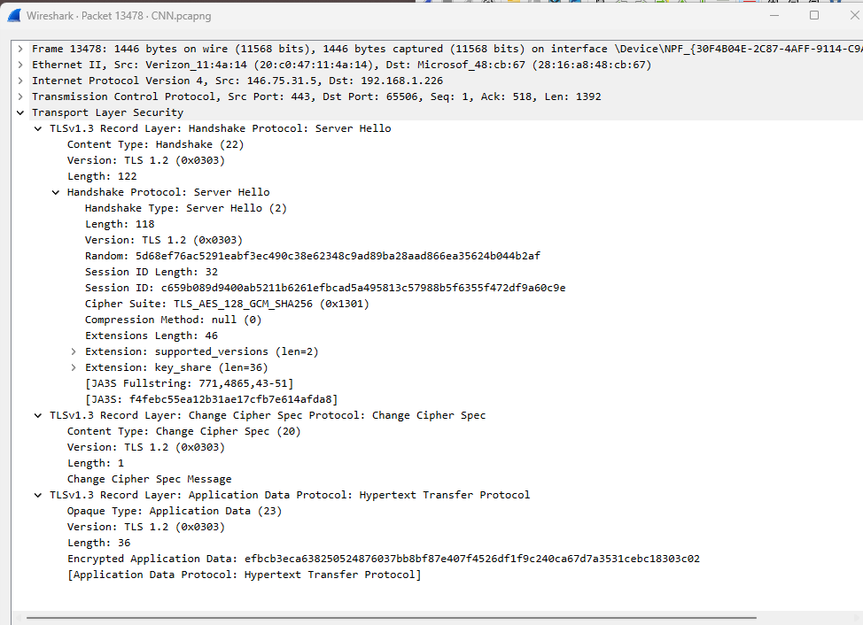
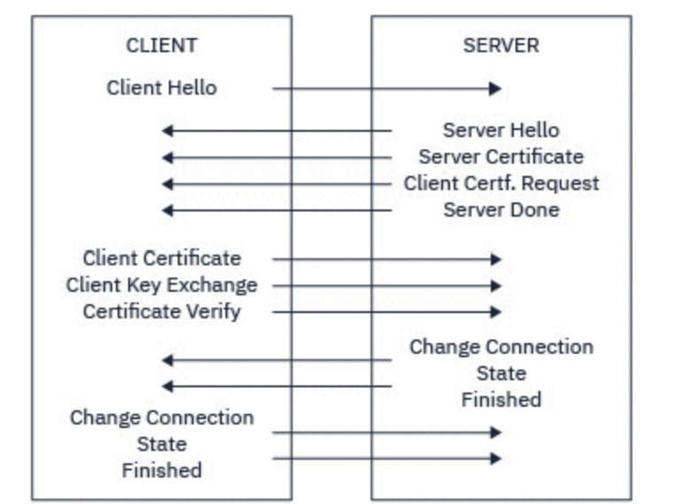
TLS: Wireshark: Server Hello
Notice it is possible for the client to exchange a certificate too. Most clients will not have a cert.

Slide 19
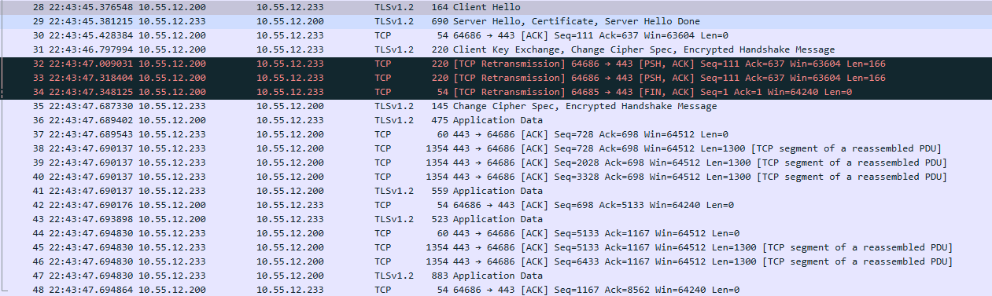
TLS: Wireshark: Handshaking: TLS 1.2 Example
Client
10.55.12.200
Message using TLS 1.2
Server
10.55.12.233

Slide 20
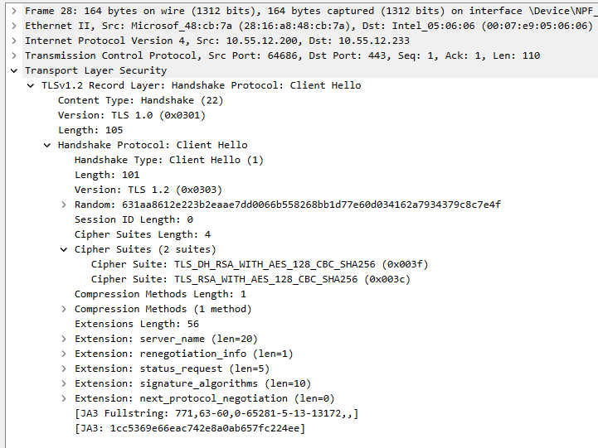
TLS: Wireshark: Client Hello TLS 1.2 Example
Client
10.55.12.200
Message using TLS 1.2
Client Key Exchange
Server
10.55.12.233

Slide 21
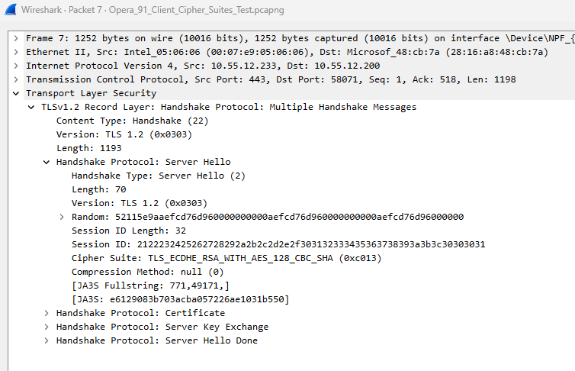
TLS: Wireshark: Server Hello: TLS 1.2 Example
Client
10.55.12.200
Message using TLS 1.2
Server Hello
Server
10.55.12.233

Slide 22
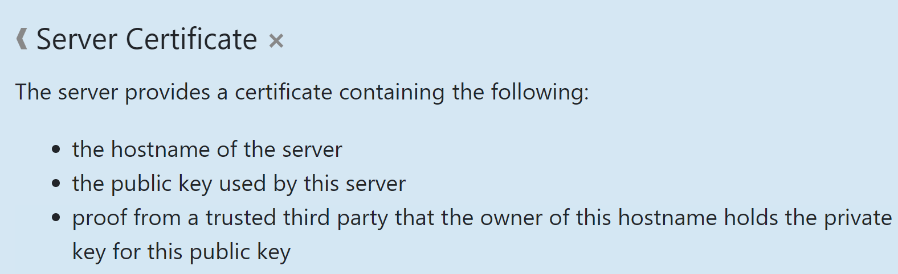
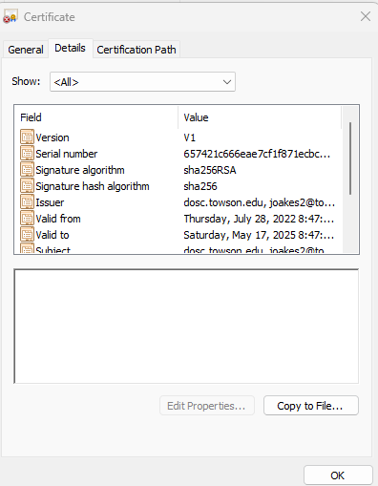
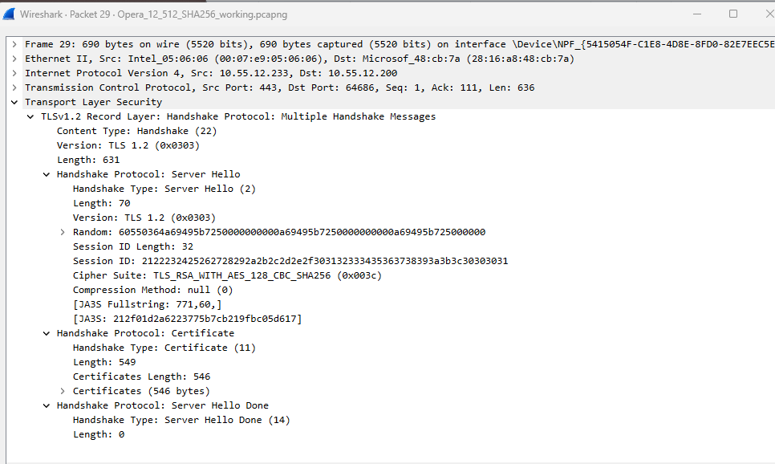
TLS: Wireshark: Certificate TLS 1.2 Example

Slide 23
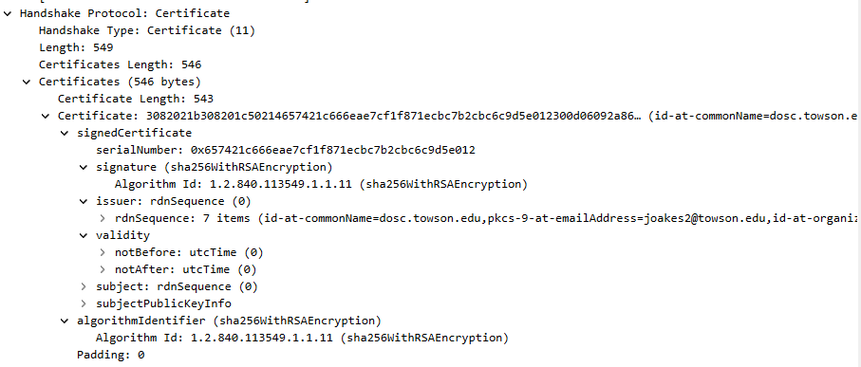
TLS: Wireshark: Certificate TLS 1.2 Example
Client
10.55.12.200
Message using TLS 1.2
Certificate
Server
10.55.12.233

Slide 24
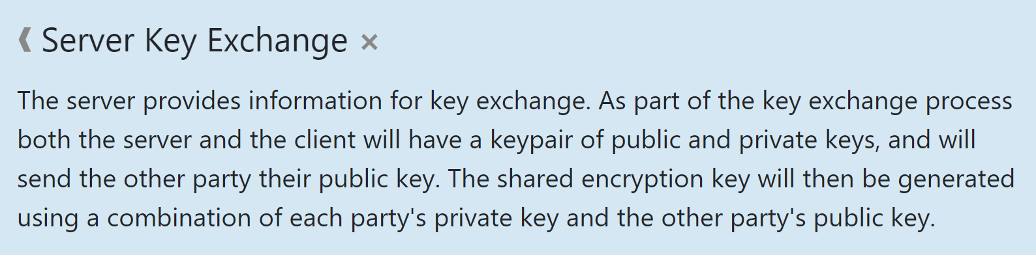
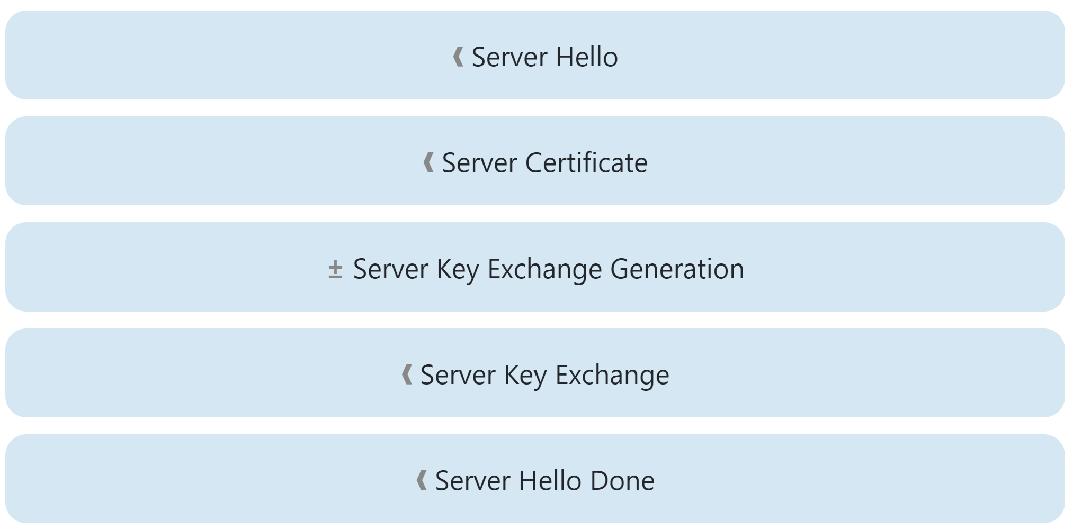


TLS: Wireshark: Key Exchange: TLS 1.2 Example
Client
10.55.12.200
Message using TLS 1.2
Server Public Key
Server
10.55.12.233
Public Key
Shared
Private Key
Not Shared

Slide 25
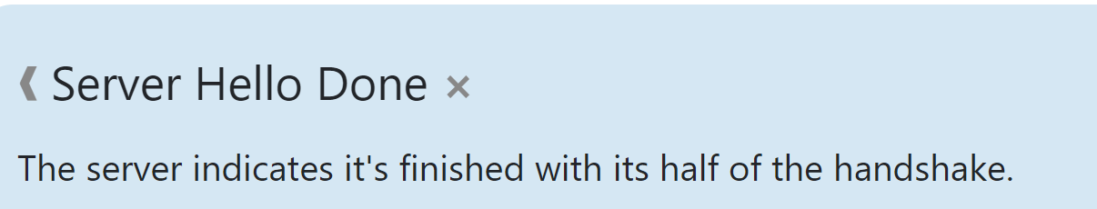
TLS: Wireshark: Hello Done: TLS 1.2 Example
Client
10.55.12.200
Message using TLS 1.2
Server Hello Done
Server
10.55.12.233

Slide 26
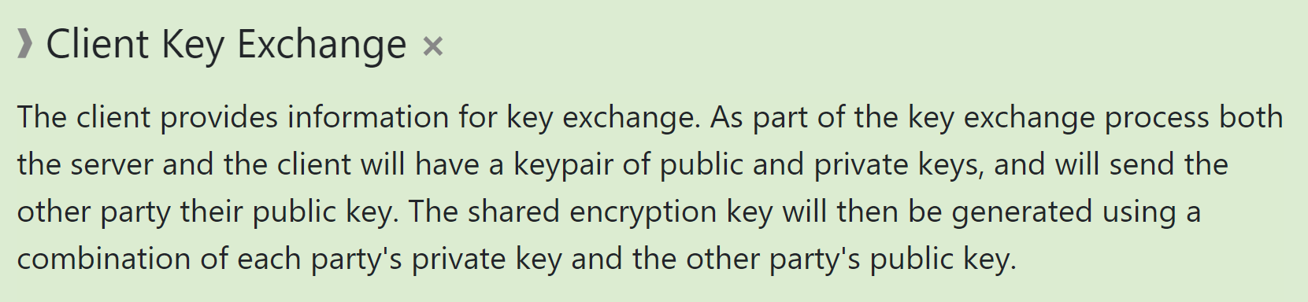
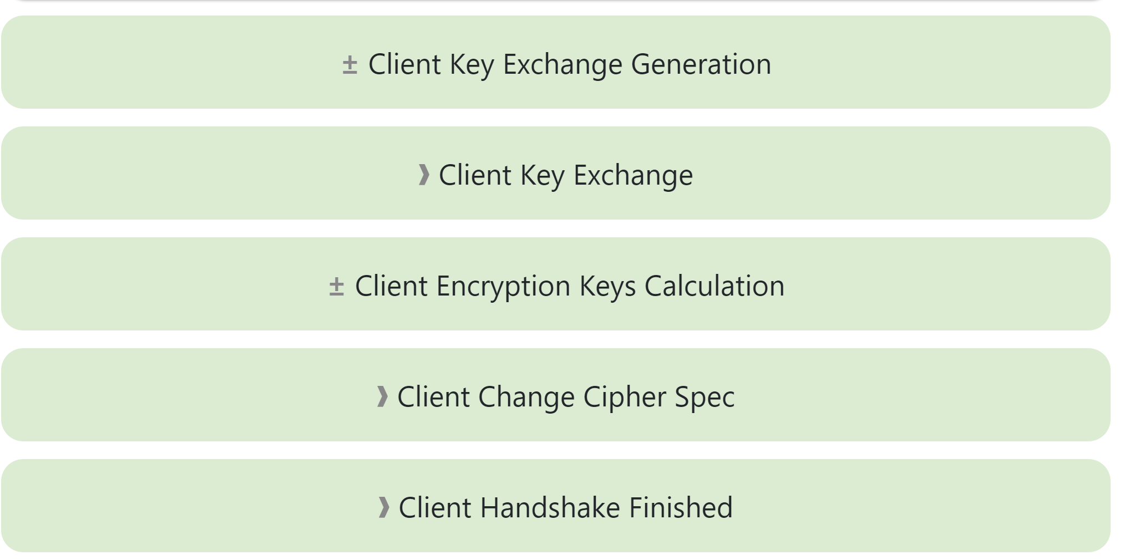
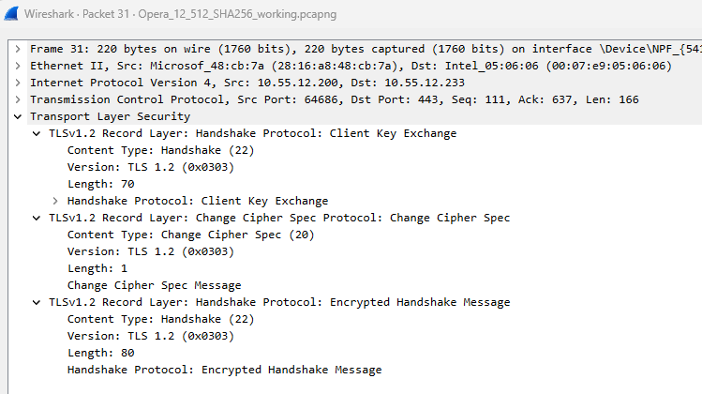
TLS: Wireshark: Client Key Exchange
Client
10.55.12.200
Message using TLS 1.2
Client Key Exchange
Server
10.55.12.233

Slide 27
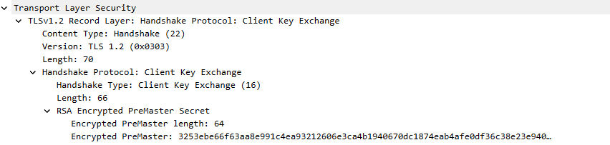
TLS: Wireshark: Client Key Exchange

Slide 28
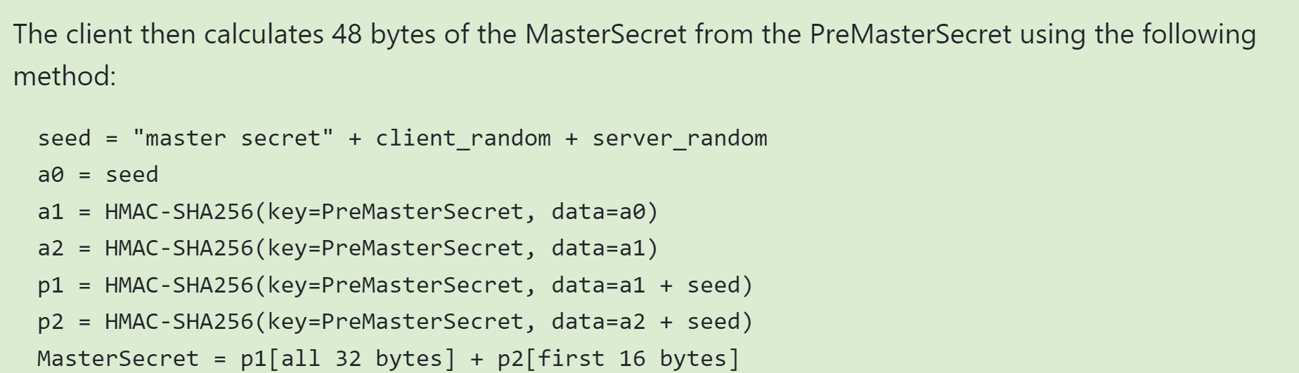
TLS: Wireshark: Master Secret Generation
Client
10.55.12.200
Message using TLS 1.2
Pre master Secret
Server
10.55.12.233
PreMasterSecret Generated
Secured using Server's Public Key
PreMasterSecret sent to Server
Client generates the Master Secret
Receives the PreMasterSecret encrypted
Decrypts using PreMasterSecret using Server's Private Key
Server generates the Master Secret

Slide 29

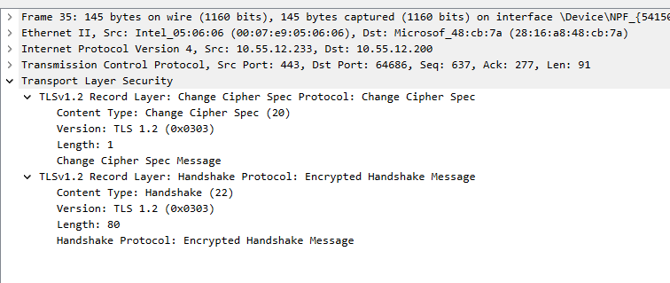
TLS: Wireshark: Change Cipher Spec
Client
10.55.12.200
Message using TLS 1.2
Change Cipher Spec
Server
10.55.12.233

Slide 30
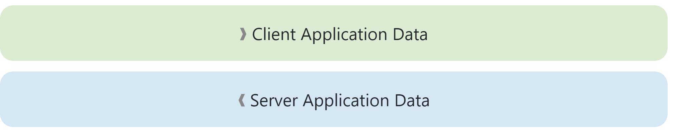
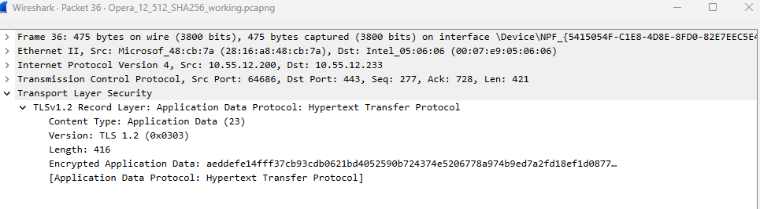
TLS: Wireshark: Encrypted Session
Client
10.55.12.200
Message using TLS 1.2
Change Cipher Spec
Server
10.55.12.233

Slide 31
Password Exchange: Works Cited
ibm.com/docs/en/ibm-mq/9.3?topic=tls-overview-ssltls-handshake
https://tls12.xargs.org/

